Slide 1
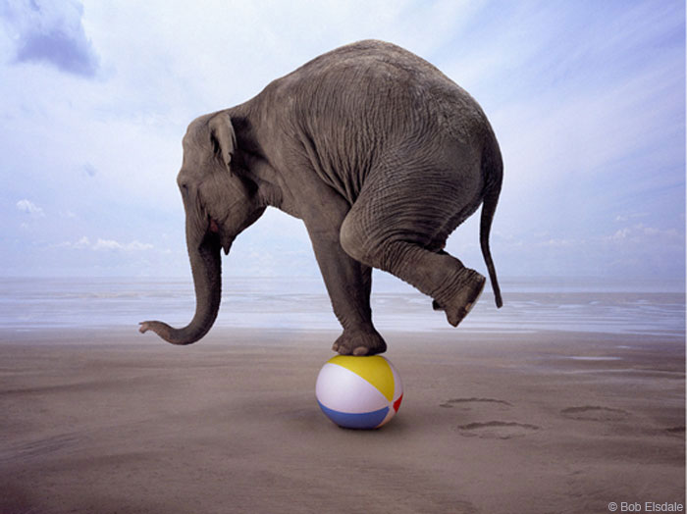
Balancing Act

Slide 2
Atoms are not created or destroyed during a chemical reaction.
Na
F
Li
Mg
O

Slide 3
Parts of a Reaction Equation
Chemical equations -
The conversion of reactants into products.
Reactants - the molecules shown on the left of the arrow.
Products - the molecules shown on the right of the arrow.
sign separates molecules on the same side
“yields”
Example
C + O₂ → CO₂
You would read this as:
“carbon plus oxygen react to yield carbon dioxide”

Slide 4
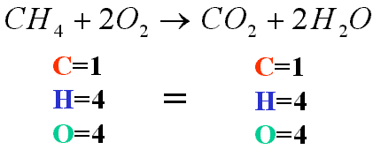
Scientists know that there must be the same number of atoms on each side of the equation. (Law of Conservation of Mass)

Slide 5
To balance an equation… you must add coefficients in front of the chemical formulas. You can not add or change subscripts.
Changing the subscripts changes the compound.
Subscripts are determined by the valence electrons
(charges for ionic or sharing for covalent)
_H + _Fe → 2HFe

Slide 6
_Ca + _O₂ →CaO

Slide 7
_N₂ + _H₂ → NH₃

Slide 8
Cu₂O +_C→ _Cu + _CO₂

Slide 9
H₂O₂ → _H₂O + _O₂

