Slide 1
Physical and Chemical Changes

Slide 2
Sodium Hydroxide dissolves into water

Slide 3
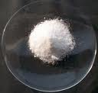
Hydrochloric acid reacts with potassium chloride to produce a salt, water and heat

Slide 4
A pellet if sodium is sliced in two.

Slide 5
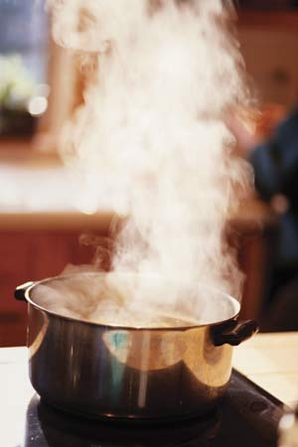
Water is heated and change into steam

Slide 6
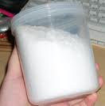
Potassium chlorate decomposes to potassium chloride and oxygen gas.

Slide 7
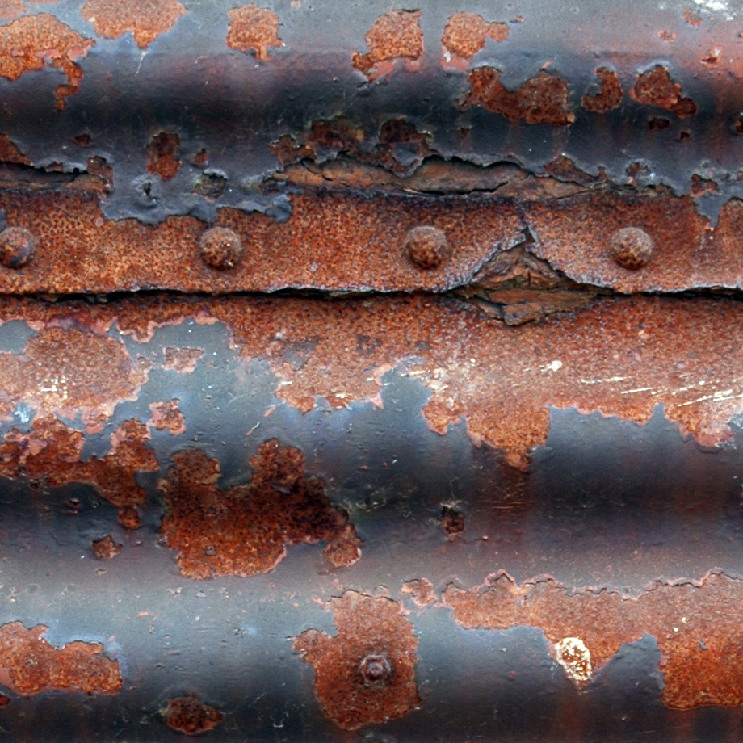
Iron rusts

Slide 8
When placing in H2O, a sodium pellet catches on fire as hydrogen gas is liberated and sodium hydroxide is formed.

Slide 9
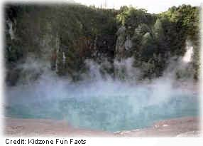
Evaporation

Slide 10
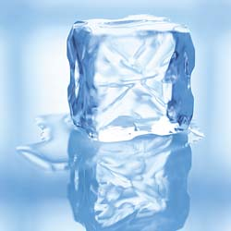
Ice melting

Slide 11
Milk sours

Slide 12
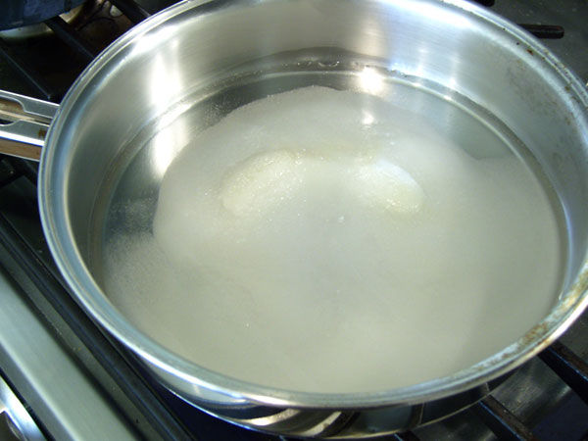
Sugar dissolves in water.

Slide 13
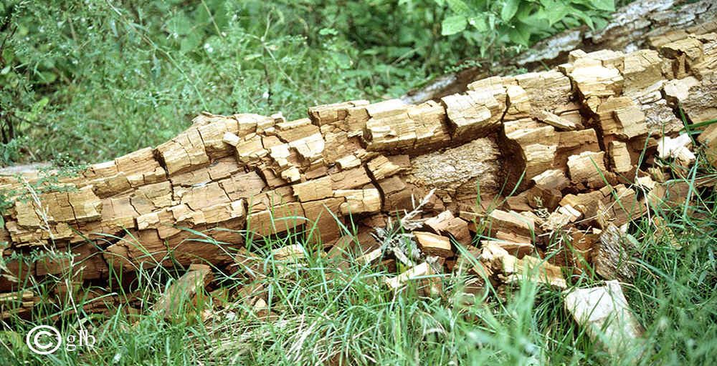
Wood rotting

Slide 14
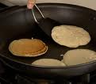
Pancakes cooking on a griddle

Slide 15
Grass growing in a lawn

Slide 16
A tire in inflated with air

Slide 17
Food digests in the stomach

Slide 18
Water is absorbed by a paper towel.

