Slide 1
Physical and Chemical Properties

Slide 2
Blue Color

Slide 3
Blue Color
Physical property

Slide 4
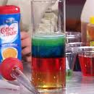
Density

Slide 5
Density
Physical property

Slide 6
Flammability

Slide 7
Flammability
Chemical property- The original substance is fundamentally changed.

Slide 8
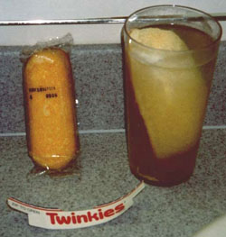
Solubility- (dissolves into a liquid to make a solution)

Slide 9
Solubility- (dissolves into a liquid to make a solution)
Physical property

Slide 10
Reacts with acid to form H2

Slide 11
Reacts with acid to form H2
Chemical property- it reacts!

Slide 12
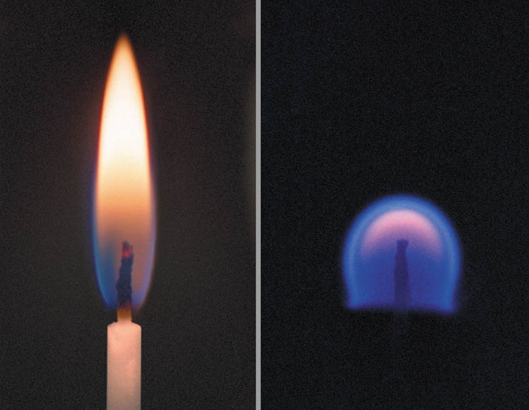
Supports combustion

Slide 13
Supports combustion
Chemical- it changes the substance.

Slide 14
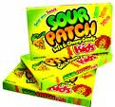
Sour taste

Slide 15
Sour taste
Physical

Slide 16
Melting point

Slide 17
Melting point
Physical… it is changing phases, but can be returned back to the original.

Slide 18
Reacts with water to form a gas

Slide 19
Reacts with water to form a gas
Chemical… it is Reacting!

Slide 20
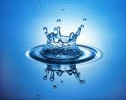
Reacts with a base to form water

Slide 21
Reacts with a base to form water
Chemical

Slide 22
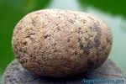
Hardness

Slide 23
Hardness
Physical

Slide 24
Boiling Point

Slide 25
Boiling Point
Physical. It doesn’t alter the substance.

Slide 26
Can neutralize a base
Fertilizer is used on roses to neutralize the basic soil.

Slide 27
Can neutralize a base
Fertilizer is used on roses to neutralize the basic soil.
Chemical. It is changing the soil.

Slide 28
Luster (How Shiny)

Slide 29
Luster (How Shiny)
You don’t alter it so its Physical.

Slide 30
Odor

Slide 31
Odor
Physical property

