Slide 2
1

Slide 3
2

Slide 4
3

Slide 5
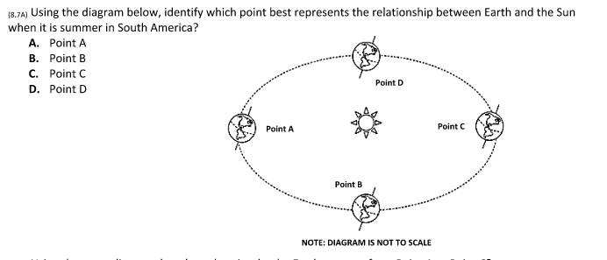
4

Slide 6
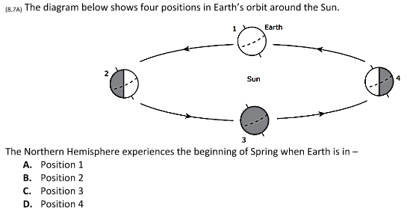
5

Slide 7
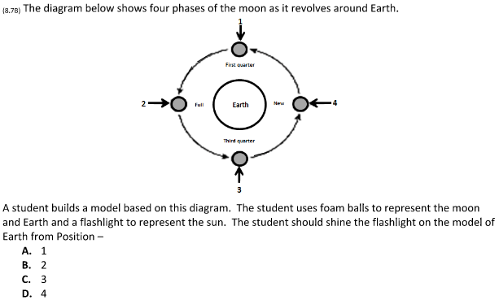
6

Slide 8
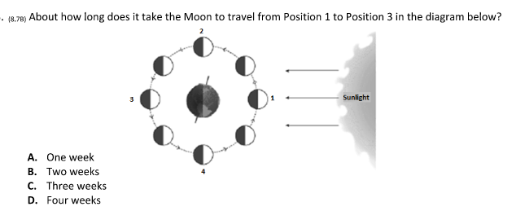
7

Slide 9
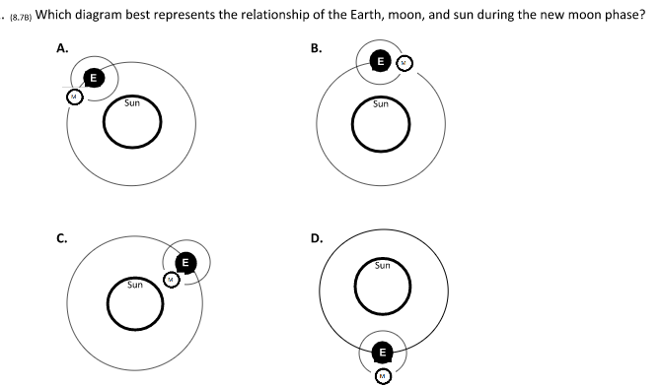
8

Slide 10
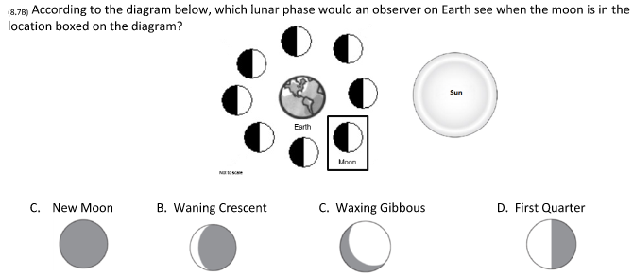
9

Slide 11
10
How many moon phases are there?
A. 8
B. 16
C. 29 1/2
D. 4

