Slide 1
10/16/12
Why do you think the rules and routines are being reemphasized today?

Slide 2
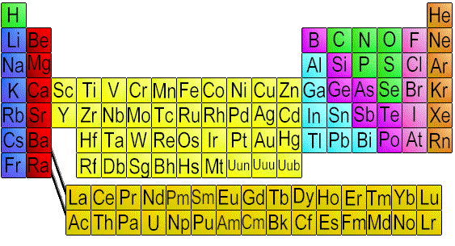
The Periodic Table

Slide 3
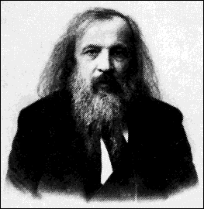
Dmitri Mendeleev
Russian Chemist

Slide 4
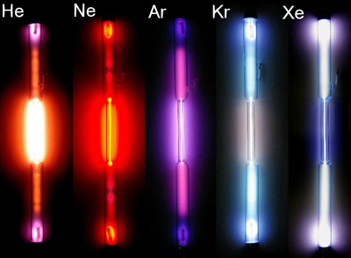
He discovered similarities in elements

Slide 5
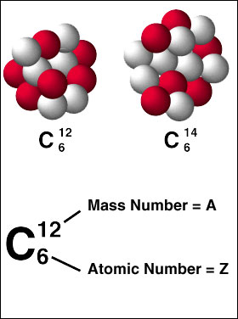
Properties included atomic mass, density, color, melting point and bonding power.

Slide 6
He made elements fit into columns. Empty spaces were elements not yet discovered….

Slide 7
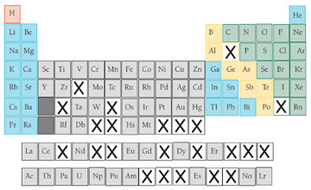
The table was still missing some elements…

Slide 8
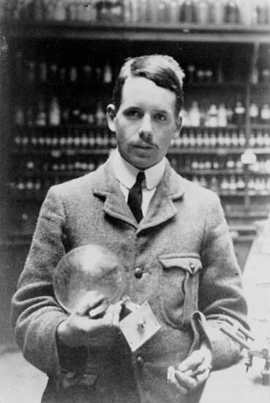
Henry Moseley
Arranged elements by atomic number, not mass.

Slide 9
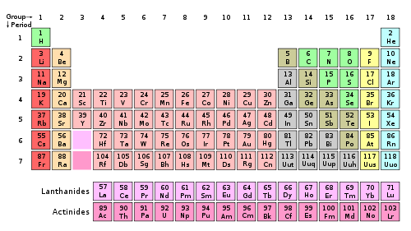
The periodic table has columns

Slide 10
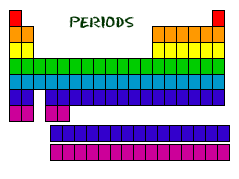
The periodic table has rows

Slide 11
Element Key

