Slide 1
What Are the Major Air Masses?
A tropical air mass forms over the tropics.
A polar air mass forms north of 50 degrees north latitude and 50 degrees south latitude.
A maritime air mass forms over the ocean.
A continental air mass forms over land.

Slide 2
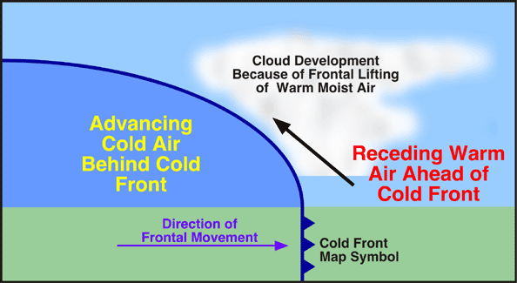
What Are Main Types of Fronts?
A cold front forms when a fast cold air mass runs into a slow warm air mass.
A cold front brings heavy rain or snow.
Move quickly, can cause
abrupt weather changes,
including violent thunderstorms.
After the front passes, cold dry air moves in, skies clear, winds shift, and temperatures drop.

Slide 3
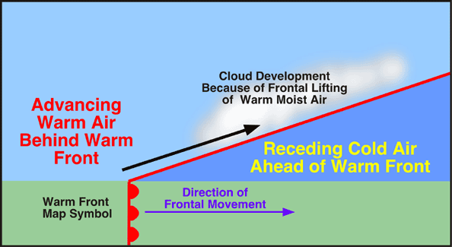
What Are Main Types of Fronts?
A warm front forms when a fast-moving warm air mass overtakes a slower-moving cold air mass.
After the front passes, weather tends to be warmer and more humid.
showers and light rain fall along front where warm and cold air meet
Move more slowly than cold fronts, weather may be rainy or foggy for several days.

Slide 4
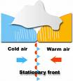
What Are Main Types of Fronts?
A stationary front forms when air masses meet, but neither can move the other.
Two air masses face each other in “standoff”
Stationary fronts often bring many days of clouds and precipitation.
When starts moving, becomes warm front if warm air advances and pushed cold air, and cold front if cold air moves forward ahead of warm air.

Slide 5
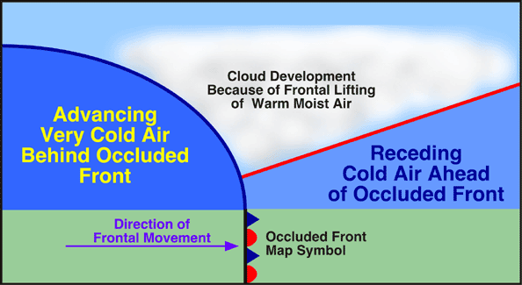
An occluded front forms when a warm air mass is caught between two cooler air masses.
Occluded fronts cause weather to turn cloudy and rain or snow may fall.
Temperature near ground becomes cooler.
Warm air mass is cut off, or occluded, from ground by cooler air beneath it.

